Slide 1
Employee Data Analysis using Excel
STUDENT NAME: ISHWARYA.G
REGISTER NO: 122204089
DEPARTMENT: B.COM CORPORATION SECRETARYSHIP
COLLEGE: SHRI KRISHNASWAMY COLLEGE FOR WOMEN

Slide 2
PROJECT TITLE
Employee gender Analysis using Excel

Slide 3


AGENDA
Problem Statement
Project Overview
End Users
Our Solution and Proposition
Dataset Description
Modelling Approach
Results and Discussion
Conclusion
3/21/2024 Annual Review

Slide 4

PROBLEM STATEMENT
The organization seeks to understand how various factors (e.g., tenure, department, job level) impact employee performance. This analysis will support HR decisions related to promotions, training, and resource allocation.

Slide 5

PROJECT OVERVIEW
Analyze employee performance data to derive insights into performance trends.- Identify key performance drivers and areas needing improvement.- Compare performance across departments, job levels, and other relevant categories.
.

Slide 6

WHO ARE THE END USERS?
HR Managers:- Inform decisions regarding promotions and rewards.- Identify training and development needs.- Allocate resources effectively based on performance data.For Senior Management:- Gain insights into organizational performance trends.- Make data-driven decisions for strategic planning.For Employees:- Understand how performance metrics are evaluated.- Identify areas for personal development and growth.

Slide 7

OUR SOLUTION AND ITS VALUE PROPOSITION
Use Excel to analyze and visualize performance data.- Create pivot tables and charts to summarize and interpret the data.- Develop a dashboard for ongoing performance monitoring.

Slide 8
Dataset Description
EMPLOYEE DATA: Includes employee ID, name, department, job level, tenure, and performance scores (e.g., ratings, KPIs).- PERFORMANCE: Various metrics such as sales numbers, project completion rates, customer feedback scores, etc.- ADDITIONAL DATA: Could include training hours, absenteeism, and other relevant factors.

Slide 9

THE "WOW" IN OUR SOLUTION
Proposed Solution:- Use Excel to analyze and visualize performance data.- Create pivot tables and charts to summarize and interpret the data.- Develop a dashboard for ongoing performance monitoring.
3/21/2024 Annual Review
9

Slide 10
MODELLING
Clean and organize the dataset.- Handle missing values and inconsistencies.Analysis techniques - **Descriptive statistics: Calculate mean, median, and standard deviation of performance scores.- Pivot Tables: Summarize performance data by department, job level, and tenure.- Charts and Graphs: Use bar charts, line graphs, and histograms to visualize performance distributions and trends.- Correlation Analysis: Assess relationships between performance scores and other factors using correlation coefficients.
10

Slide 11
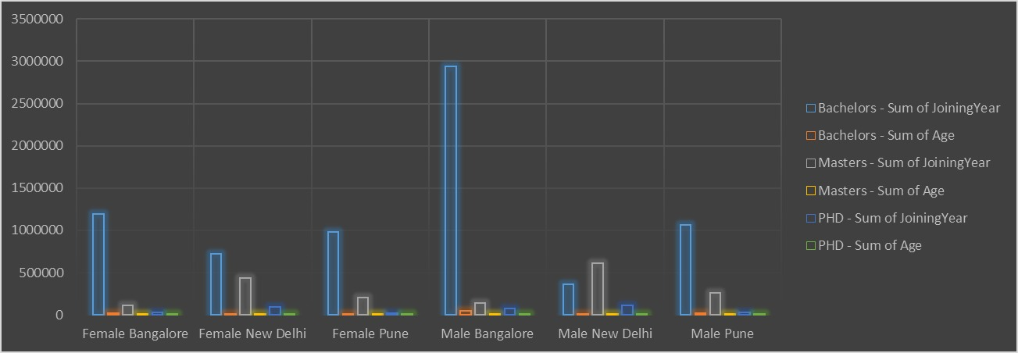
RESULTS
11

Slide 12
conclusion
Summary:- Recap of key findings from the performance analysis.- Overall assessment of performance trends and patterns.Recommendations:- Suggested actions based on the analysis to enhance employee performance.- Recommendations for targeted training and development initiatives.Future Work:- Suggestions for further analysis or data collection.- Consideration of additional metrics or factors for future evaluations.

